Slide 1
High School & Middle School Rugby
Registration Open NOW
Mudturtle Rugby
Spring Season runs from March through May
Practice – Winter – Sundays mornings
Spring – Tuesday and Thursday Evenings
Nice balance of competitiveness yet social
All shapes and sizes needed
College money available NCAA varsity sport
Rugby is the fastest growing sport in the USA
Open to ALL High School or Middle School Boys and Girls – no matter what school
Teams:
U12 Boys
U14 Boys
U16 Boys
U19 Boys
U14 Girls
U19 Girls
www.mudturtlerfc.com
NO EXPERIENCE NECESSARY
Practice: 10 a.m. Sunday -- 12/10/17 – 1/28/18
Rahway River Park, Rahway, NJ (Turf Field)
For More Information Contact: info@mudturtlerfc.com

Slide 2
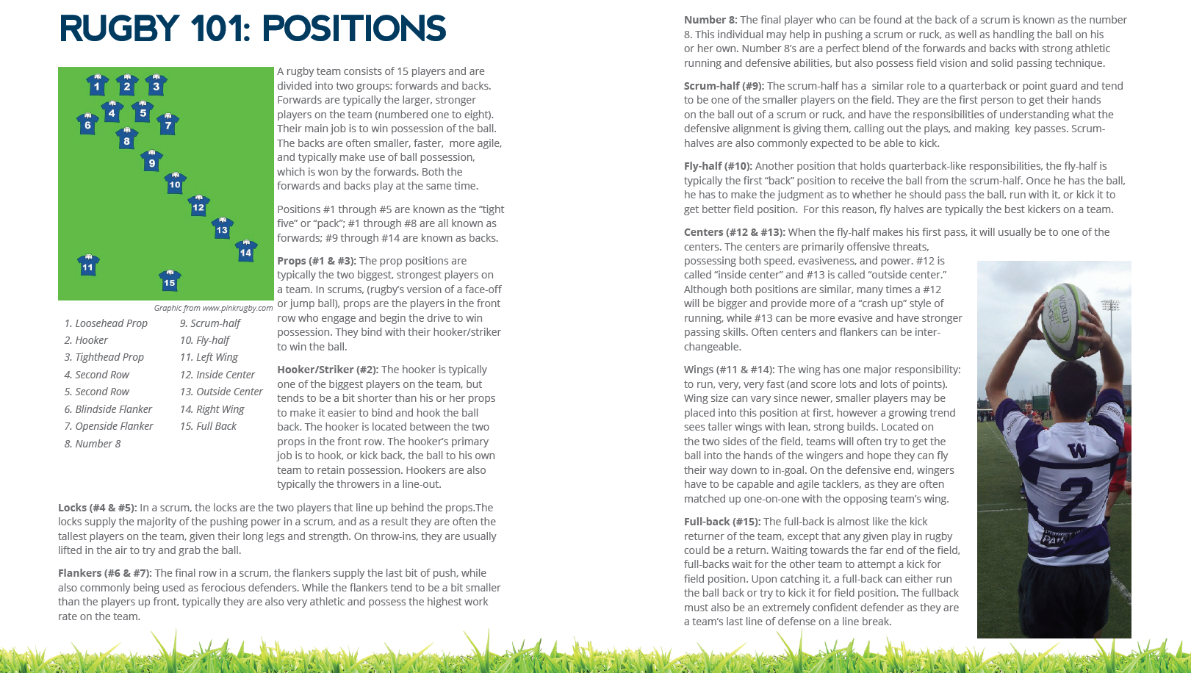
Borrowed from Ruggers Edge College Playbook

